Slide 1
SPRINT 4: Triathlon Performance
By Kooper K, Esha A, and Anthony S

Slide 2





Challenges Faced
Charging
The robot at times was not fully charged during testing. Making the process longer.
Time
Not enough time to fully flesh out SDD and block codes.
Meeting
Meeting at times was difficult as we are all commuters.
Learning curve
The program itself was a struggle and inconsistent at times.

Slide 3
Roles of Team
Esha
Kooper
Anthony
Editor: Edits the final SDD, tests the robot and gets the video for gitHUB repository.
Project Supervisor: Divides roles, works on all aspects of the project. Oversees progress of the project.
Management and Editor: Edits the final SDD, tests the robot and gets the video for gitHUB repository.

Slide 4
What We Learned on Software Engineering
Learned more on Github sharing
Learned Test Plan chart
Experience in the tedious amount of work for SDD and Gantt Chart
Learned scheduling
Learned importance of group roles

Slide 5
What we Would do Differently
Conference more on meeting dates
Succeed
Combine all of our knowledge to be both prepared and thorough in our project.
Fix Errors
Charge Robot
Comb over spelling mistakes and make sure everything is properly submitted
Remember to charge the robot so we do not have to wait for so long

Slide 6
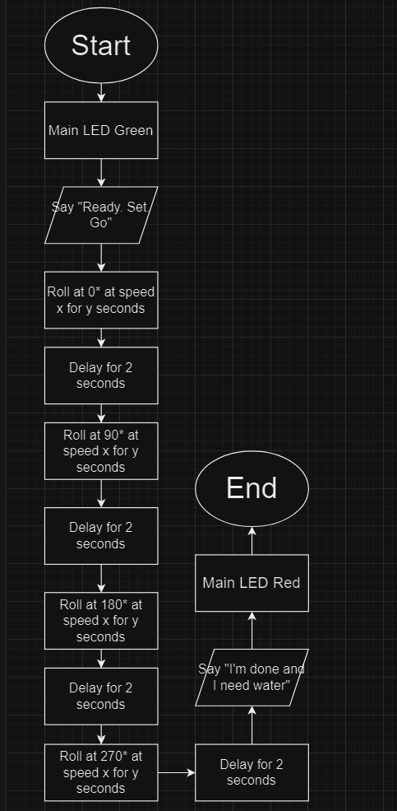
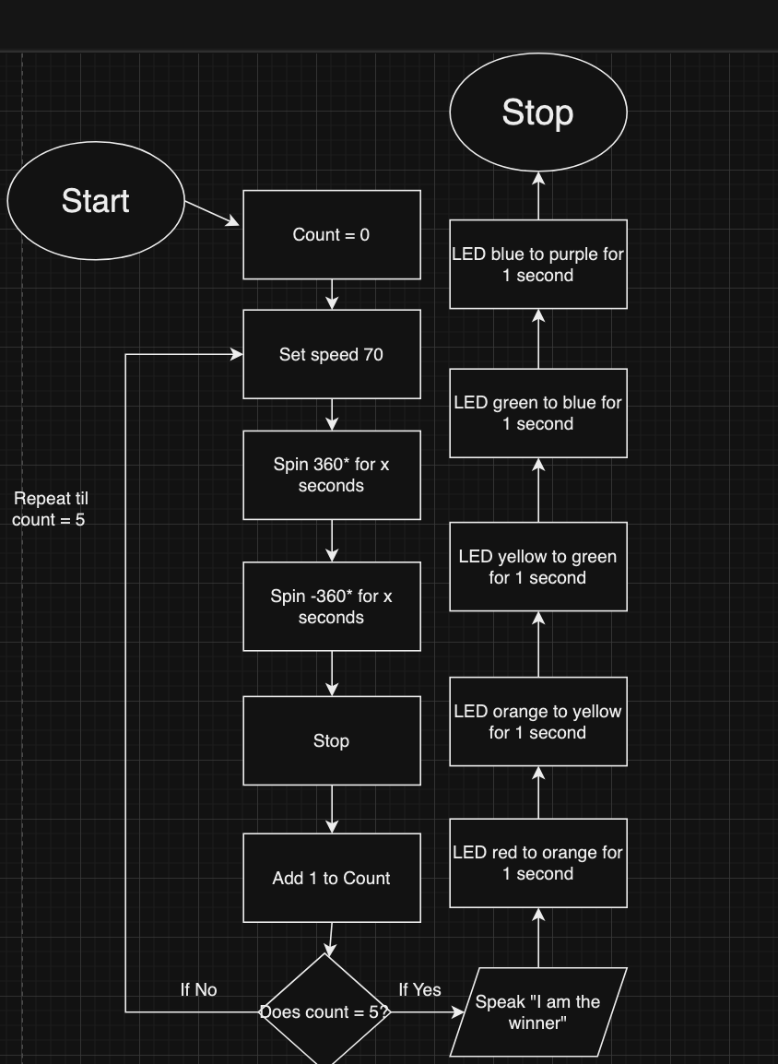
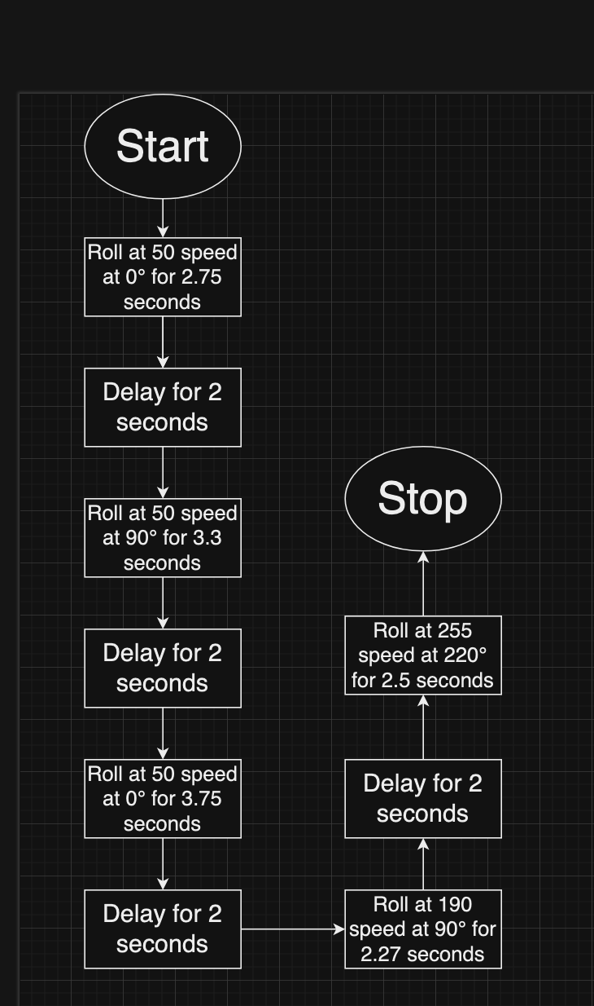
Block Codes:
SPRINT 1:
SPRINT 3:
SPRINT 2:

Slide 7
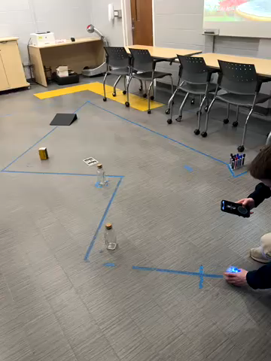

Slide 8

Fin

